Slide 1
Shiny Apps
A lifechanging experience in R

Slide 2
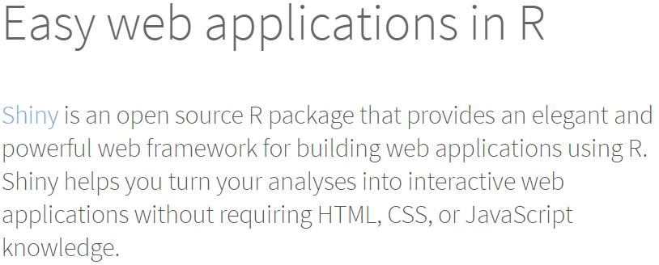


Slide 3

Why Shiny?
Because this is the worst possible way to deliver your model results to the decision makers who need the insights on-demand.
The most powerful, insightful model in the world generates NO value if it only runs on your laptop.

Slide 4
Sprout demo with #UTK tweets

Slide 5
Shinyapps.io Hiking App
https://markewing.shinyapps.io/Hiking_App/

Slide 6
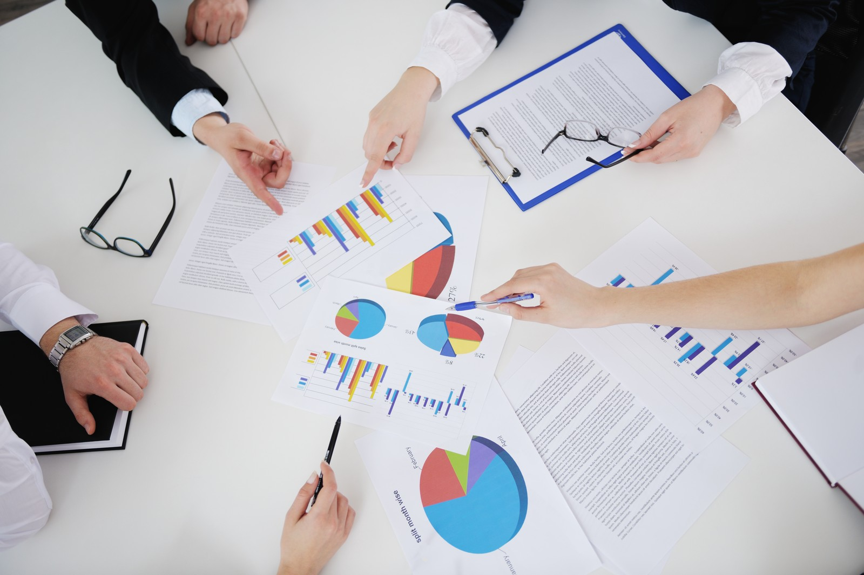


Why Shiny?
Why not Excel?

Slide 7
Why Shiny?
Version 1.0
?
Version 2.0

Slide 8
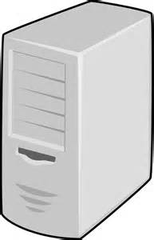
Why Shiny?
Version 1.0
Version 2.0

Slide 9
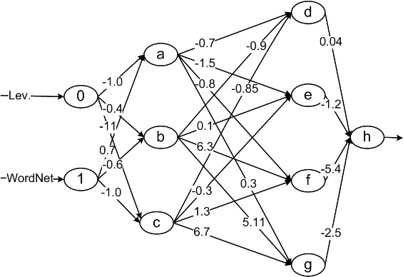
Why Shiny?
?

Slide 10


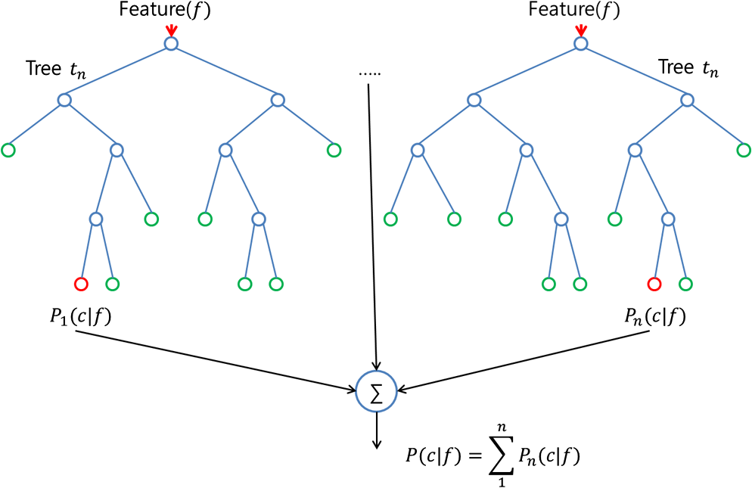
Why Shiny?
Etc.

Slide 11
First App in RStudio

Slide 12



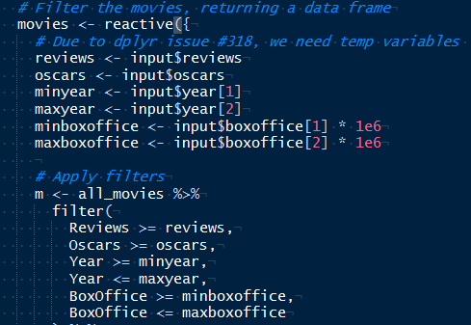
We can do better
RStudio
Shiny Apps
Shinydashboard
Notes:
Assignment will focus on shiny dashboard
shinyDB provides a lot of structure, but you can be as creative as you want with shiny
Talk about reactivity some (motivate with why make app if only static)
Only limited by imagination and motivation to learn new skills

Slide 13
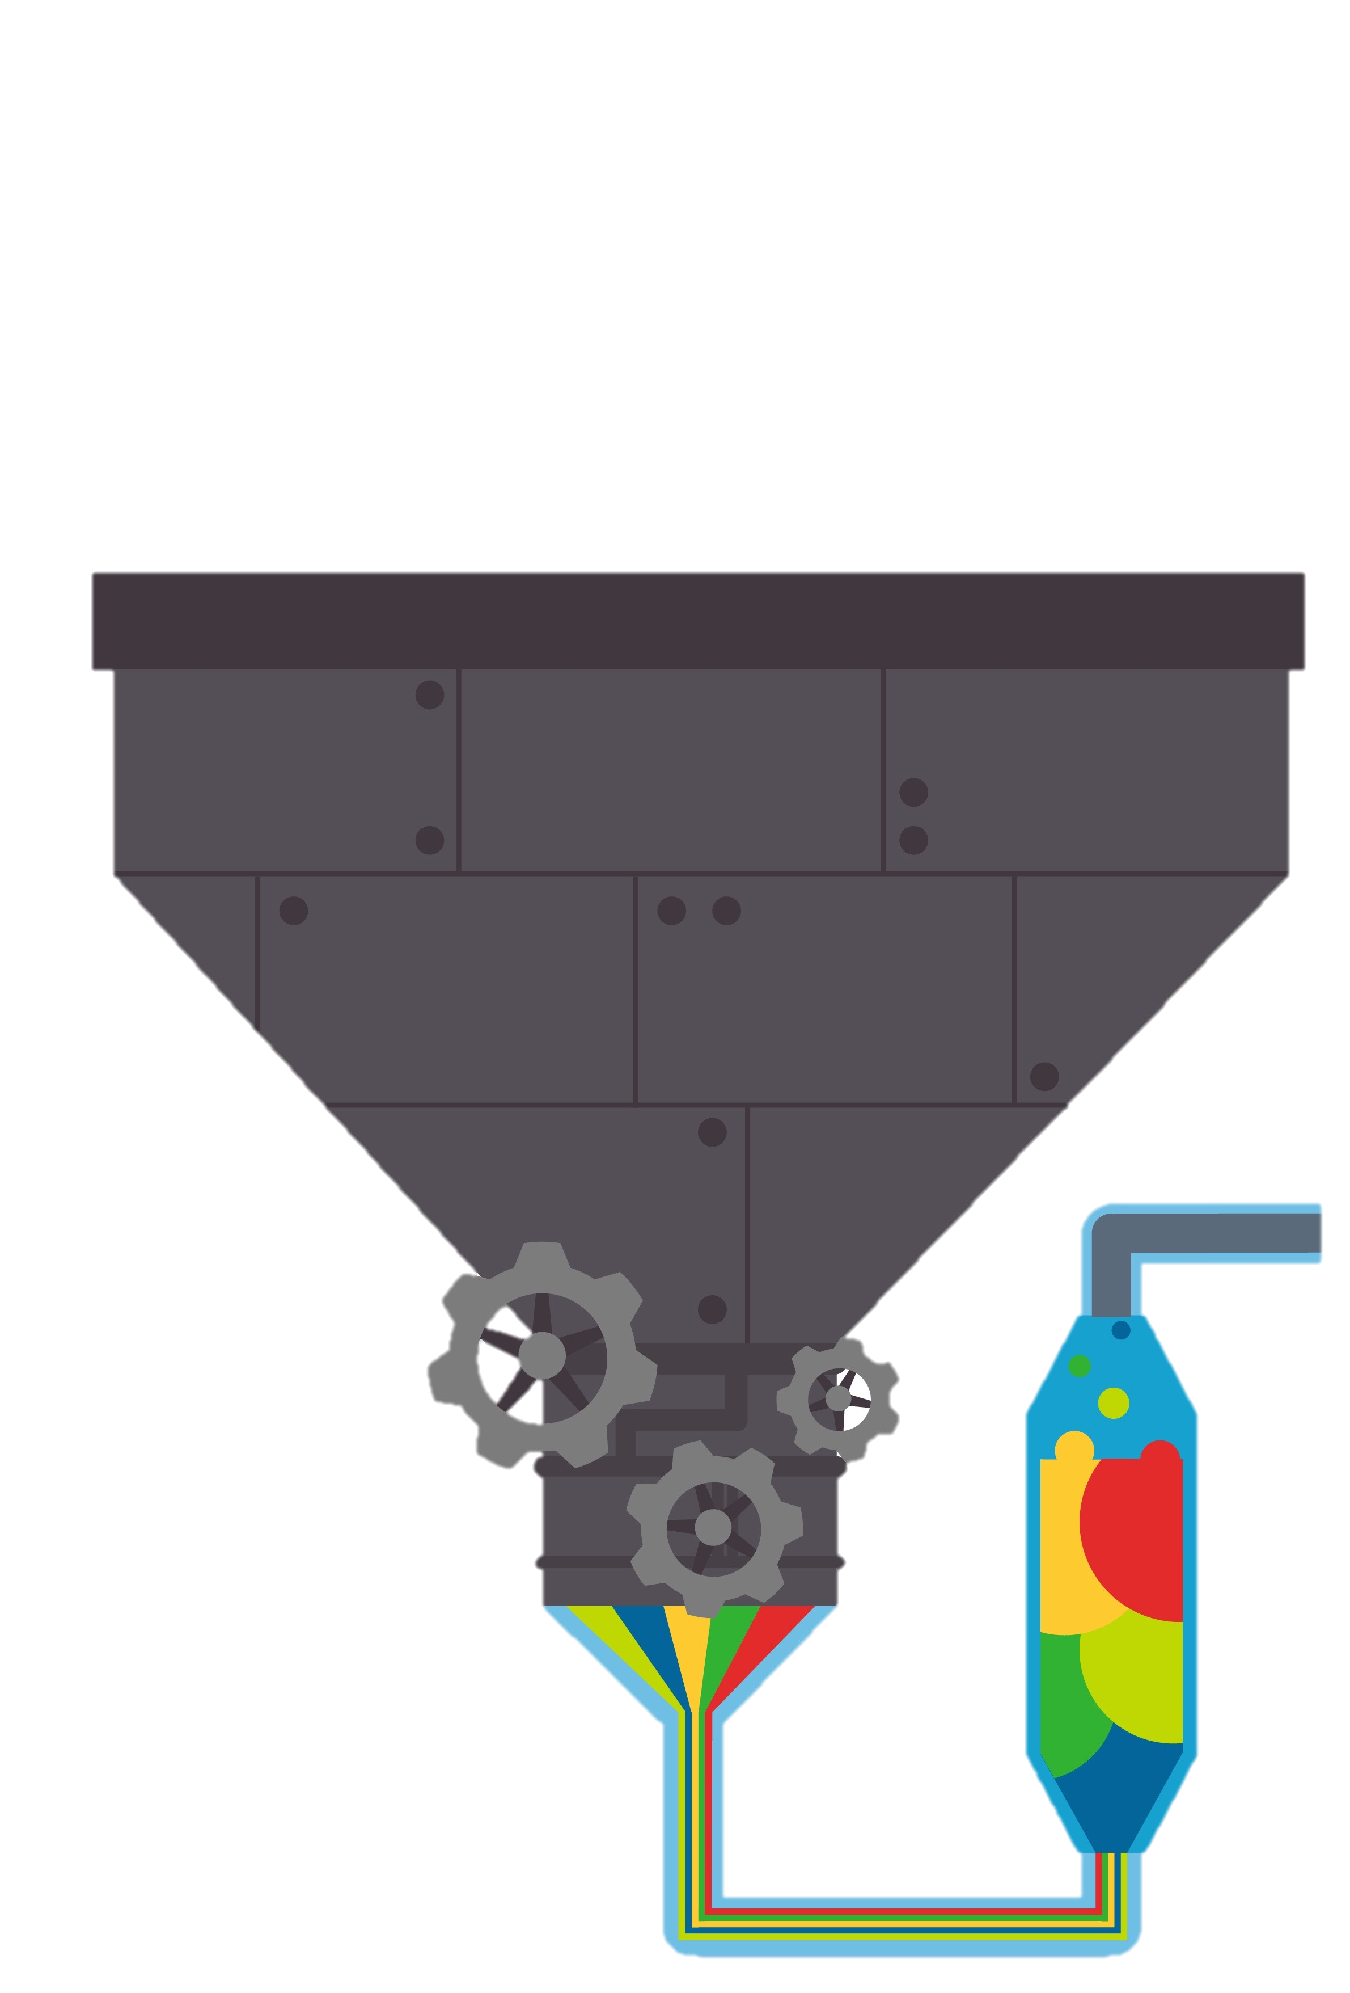
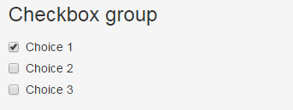
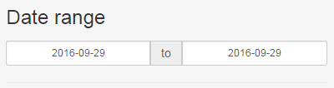
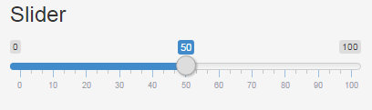
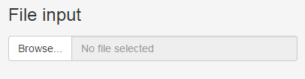
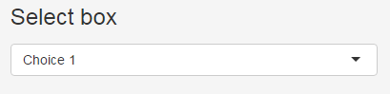

Inputs
Numeric inputs
Slider inputs
Select inputs
Single
Multiple
Widget Page

Slide 14
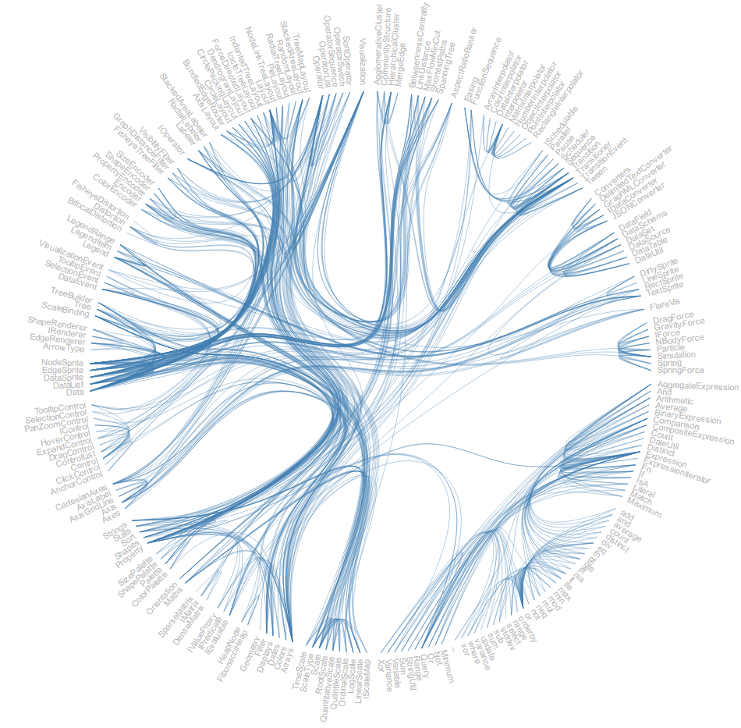
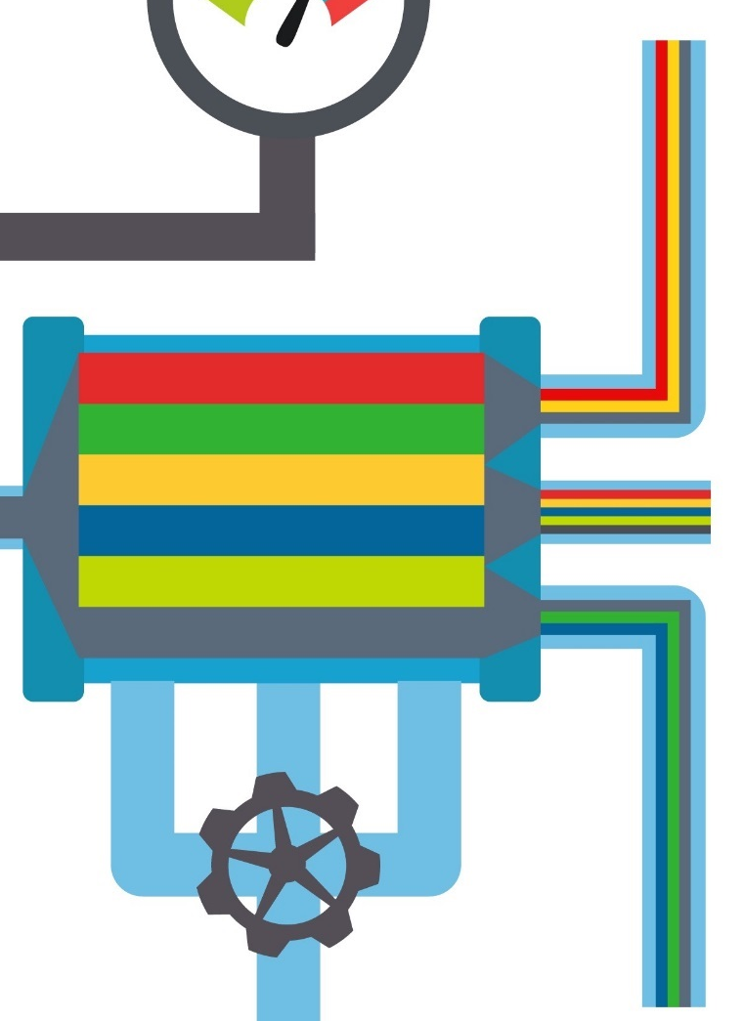
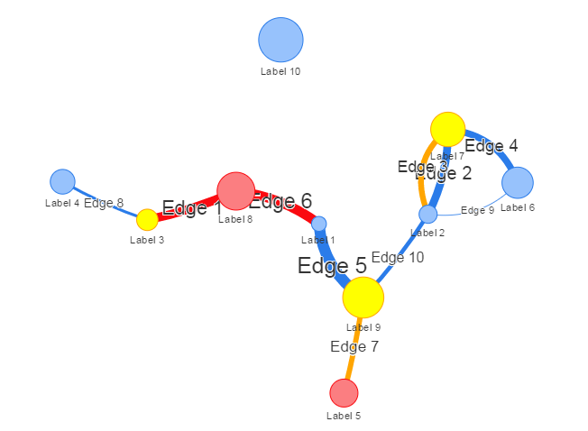
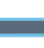
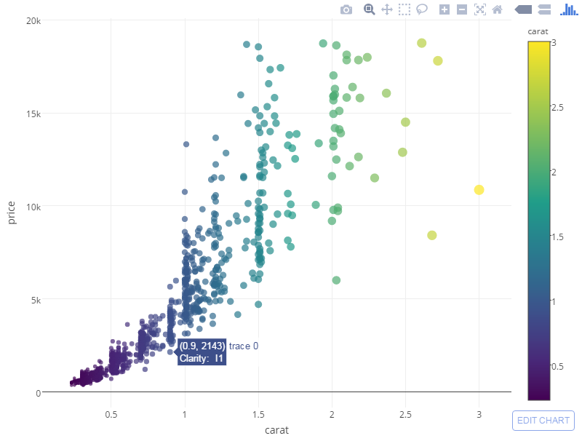
Outputs
Basics
UI element
verbatimTextOutput
textOutput
Server rendering
renderPrint
renderText
Graphics
plotOutput
renderPlot

Slide 15
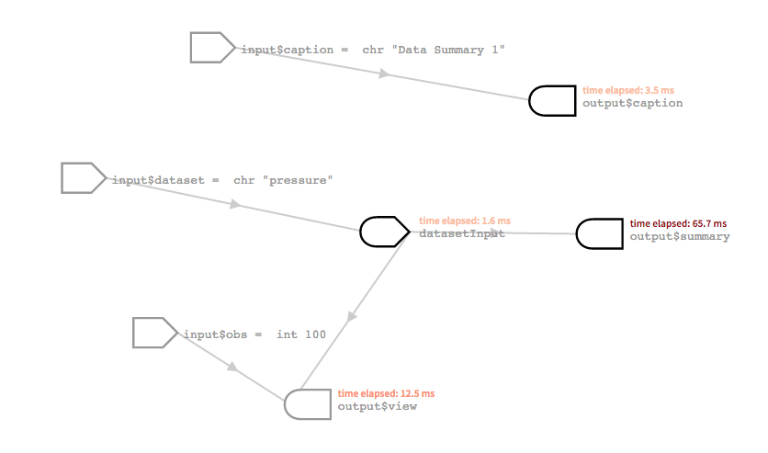
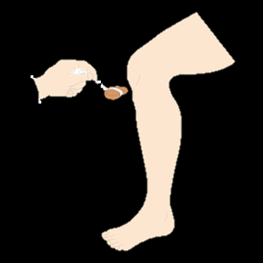
Reactives
Input → Reactives → Output
Overview
Lazy
Syntax()

Slide 16
Fancy it up

Slide 17
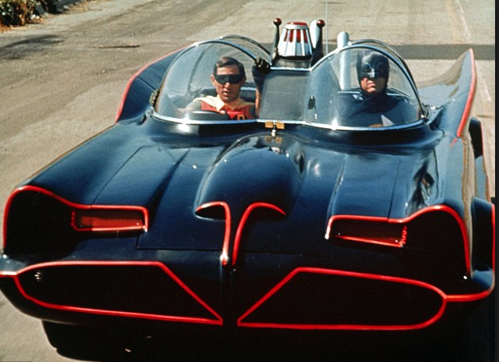
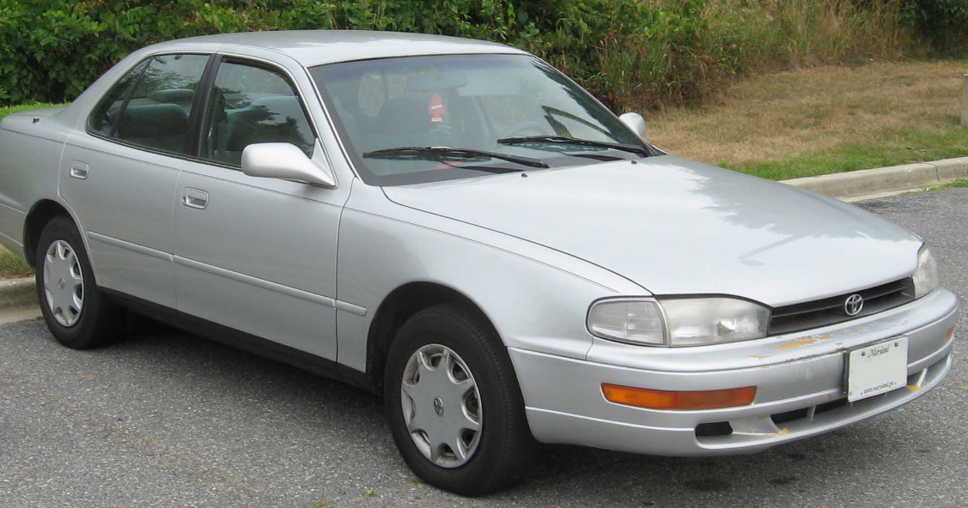
VS

Slide 18
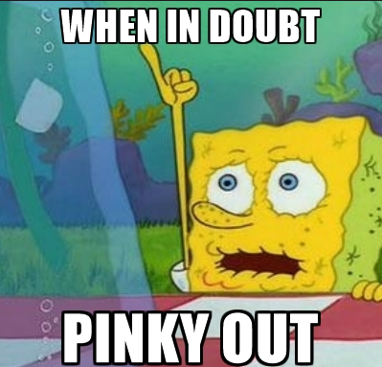
Its Easy to be Fancy!
HTML Widgets
These libraries are built on other people’s hard work in Javascript and HTML

Slide 19
Fancy tables
library(DT)
Javascript running in the background – invisible to you
Displays data in a much cleaner way while also allowing for interactivity, searching, and much more!

Slide 20
Fancy graphs
library(plotly)
[see also library(ggvis),library(ggplot2)]
Allows all the interactivity of Tableau and so much more!

Slide 21
Publishing to shinyapps.io

Slide 22
http://www.shinyapps.io/

Slide 23
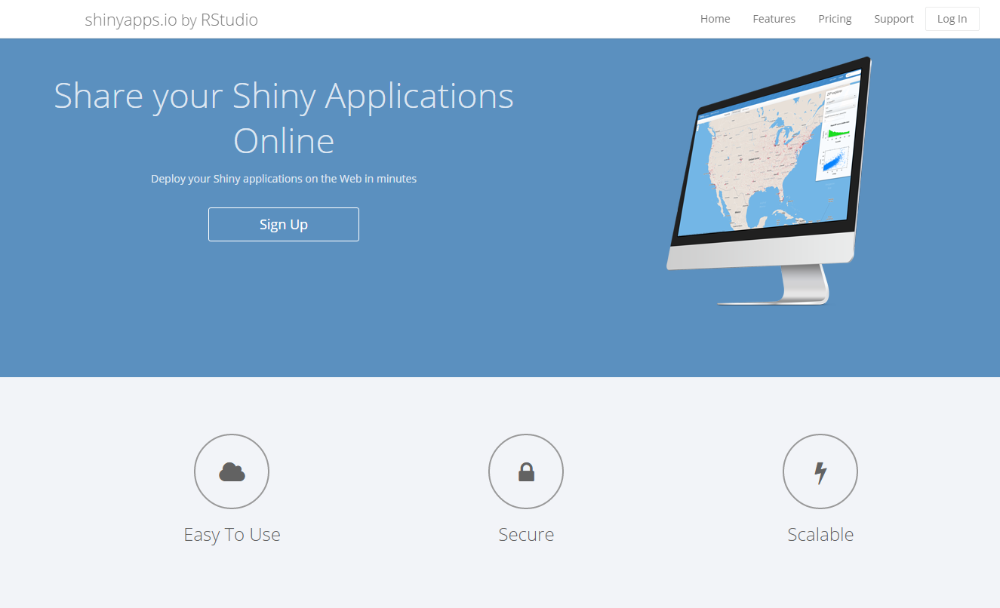

Slide 24
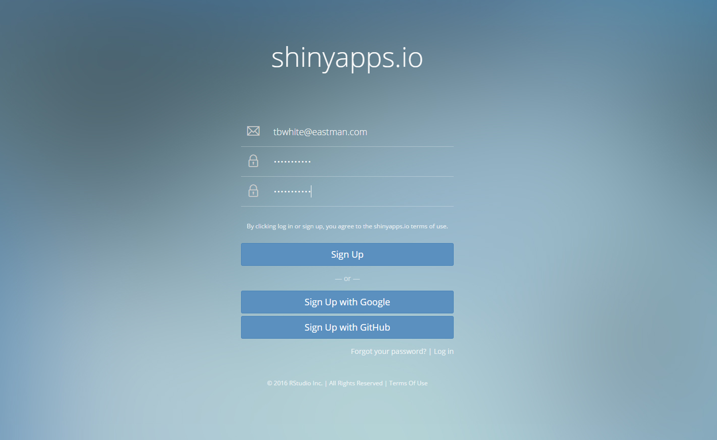

Slide 25
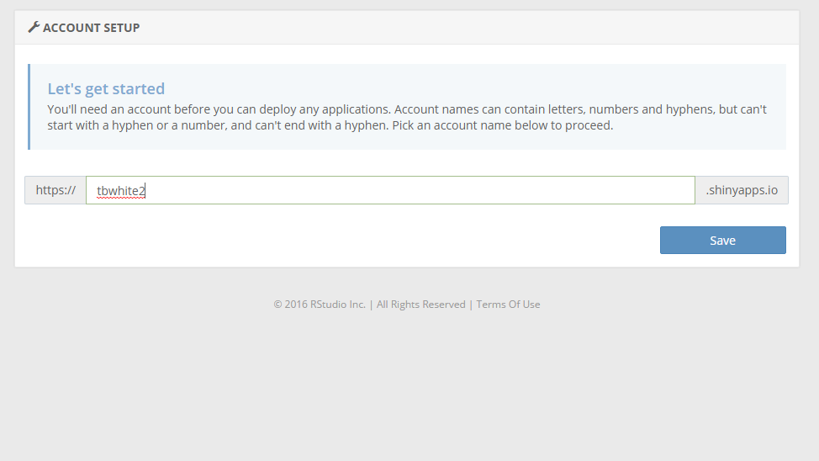

Slide 26
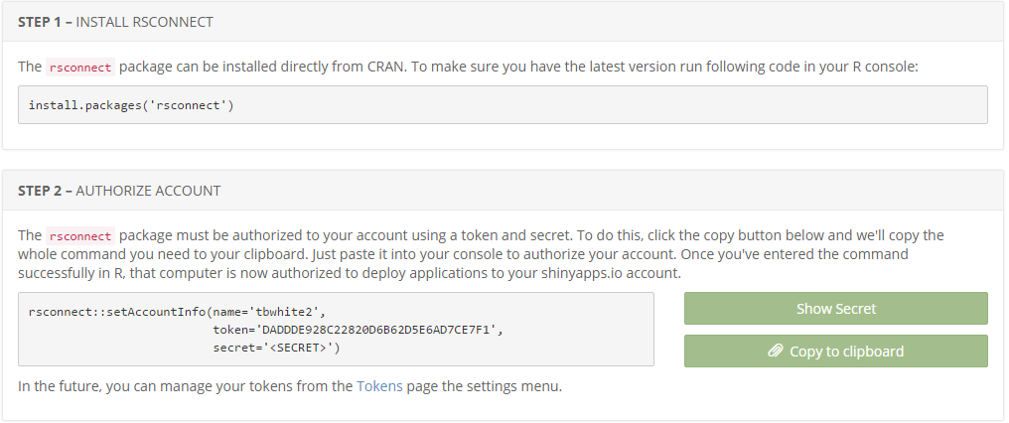

Slide 27
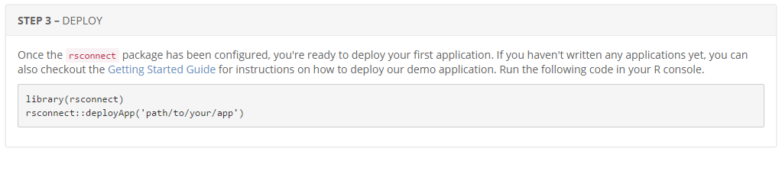

Slide 28
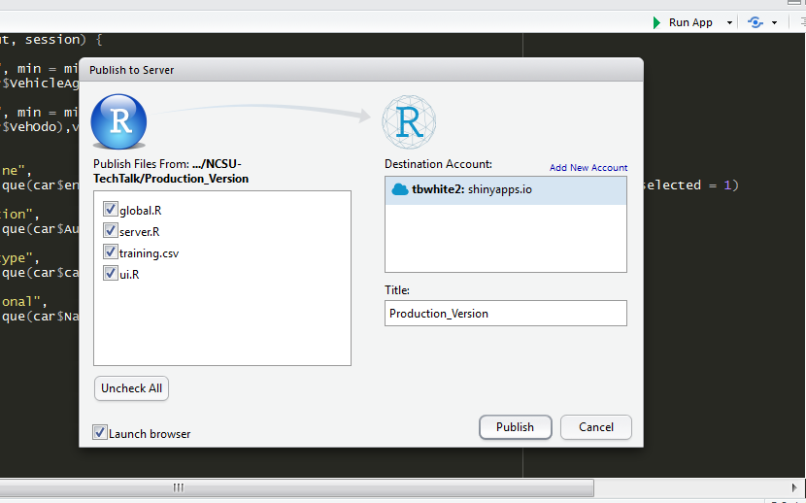

Slide 29
Assignment

Slide 30
Predicting Lemons
Build a dashboard to help a car bidder avoid buying lemons
Given key model predictors, allow the bidder to avoid buying lemons
Include supporting plots of the data
Be creative
Publish your Shiny app to shinyapps.io
Include your source code
Present your dashboard the class and us next week

